Slide 1
Savitribai Phule Pune University F. Y. B. Sc. (Semester- I) CH- 101: Physical Chemistry Chapter 3: Ionic Equilibria Lecture: 1
- Sandesh Dasharath Kasar,
Assistant Professor,
Department of Chemistry,
Agasti Arts, Commerce and Dadasaheb Rupwate Science College, Akole

Slide 2
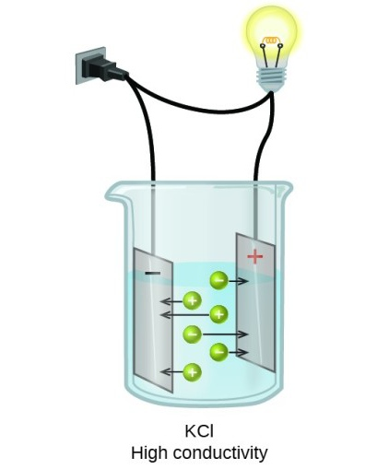
Electrolytes
Those substances which conduct electricity in an aqueous solution due to presence of ions are called as electrolytes.
e. g. Acids, Bases and salts

Slide 3
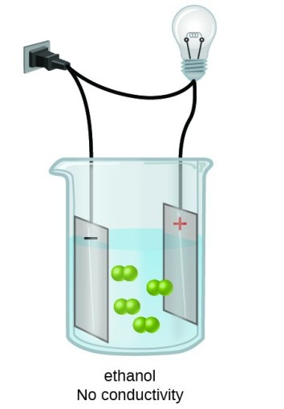
Non- electrolytes
Those substances which do not conduct electricity in aqueous solutions due to absence of ions. are called as non- electrolytes.
e. g. Glucose, sucrose, glycerol, urea, hydrocarbons.

Slide 4
Electrolytes are further classified into...
Strong electrolytes
Moderate electrolytes
Weak electrolytes

Slide 5
Strong electrolytes
The electrolytes when dissolved in water ionise or dissociates almost completely are called strong electrolytes.
e. g.
Most soluble salts
Strong acids (H2SO4, HNO3, HCl etc.)
Strong bases (NaOH, KOH etc.)

Slide 6
Weak electrolytes
The electrolytes when dissolved in water ionise or dissociates only partially to the extent of 5% are called weak electrolytes.
e. g.
Weak acids (CH3COOH, H2CO3 etc.)
Weak bases (NH3, NH4OH etc.)

Slide 7
Moderate electrolytes
The electrolytes when dissolved in water ionise or dissociates to about 50% may be called as moderate electrolytes.
e. g.
Under optimised conditions of concentration and temperature strong electrolyte may behave like moderate electrolyte.

Slide 8
Reference
Essentials of Physical Chemistry by Arun Bahl, B. S. Bahl and G. D. Tuli, S. Chand Publications.
Physical Chemistry, F. Y. B. Sc. (Semester- I), Manali Prakashan, Pune

Slide 9
Savitribai Phule Pune University F. Y. B. Sc. (Semester- I) CH- 101: Physical Chemistry Chapter 3: Ionic Equilibria Lecture: 2
- Sandesh Dasharath Kasar,
Assistant Professor,
Department of Chemistry,
Agasti Arts, Commerce and Dadasaheb Rupwate Science College, Akole

Slide 10
Ionisation or Dissociation
According to Arrhenius theory of ionisation, the molecules of electrolytes when dissolved in aqueous solution split up into positively and negatively charged particles called cations and anions.
This splitting phenomenon of electrolytes in aqueous solution is called ionisation or dissociation of electrolyte.

Slide 11
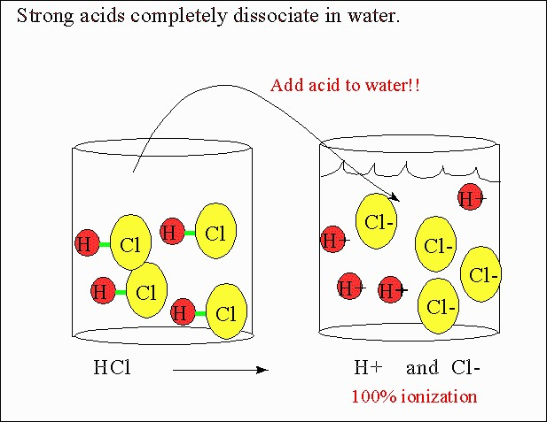

Slide 12
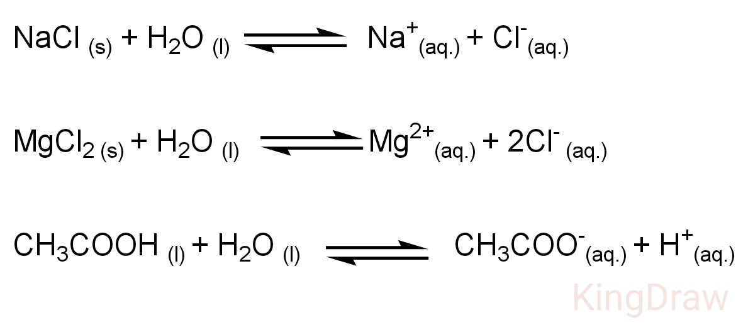
Consider the ionisation of following electrolytes in water

Slide 13
Ionic equilibria
The ions produced by ionisation of electrolytes combine back to give un- dissociated molecules.
There exist equilibriums between ions produced and un- dissociated molecule called ionic equilibria.

Slide 14
Degree of ionisation
Degree of ionisation (𝛂) = --------------------------------
Number of molecules ionised or dissociated
Total number of molecules

Slide 15
The fraction of total number of molecules of the electrolyte that split or ionises into the cations and anions is called degree of ionisation or degree of dissociation.
The degree of ionisation usually increases with dilution and its value becomes maximum at infinite dilution.

Slide 16
Reference
Essentials of Physical Chemistry by Arun Bahl, B. S. Bahl and G. D. Tuli, S. Chand Publications.
Physical Chemistry, F. Y. B. Sc. (Semester- I), Manali Prakashan, Pune

Slide 17
Savitribai Phule Pune University F. Y. B. Sc. (Semester- I) CH- 101: Physical Chemistry Chapter 3: Ionic Equilibria Lecture: 3
- Sandesh Dasharath Kasar,
Assistant Professor,
Department of Chemistry,
Agasti Arts, Commerce and Dadasaheb Rupwate Science College, Akole

Slide 18
Factors affecting Degree of Ionisation
Nature of electrolyte
Nature of solvent
Concentration of electrolyte
Temperature
Presence of common ions

Slide 19
1. Nature of electrolyte
Weak electrolytes are partially ionised, therefore their degree of ionisation is low.
Strong electrolytes are completely ionised, therefore their degree of ionisation is high.
Therefore ionic electrolytes have higher degree of ionisation.

Slide 20
2. Nature of solvent
Solvents with high dielectric constant and high solvating power ionises the electrolytes to greater extent than the solvents with low dielectric constant.
e. g. Water > Benzene

Slide 21
3. Concentration of electrolyte
The extent of dissociation of an electrolyte is inversely proportional to the concentration of its solution.
The less concentrated the solution, the greater will be the dissociation of the electrolytes.
This is due to the fact that in a dilute solution the ratio of solvent molecules to the solute molecules is large and the greater number of solvent molecules will separate more molecules of the solute into ions.

Slide 22
4. Temperature
The ionisation is an endothermic process.
Hence degree of ionisation increases with increase in temperature.

Slide 23
5. Presence of common ions
The presence of common ions tends to reduce the degree of ionisation.
This phenomenon is known as common ion effect.
e. g. The ionisation of ammonium hydroxide decreases in presence of ammonium chloride.

Slide 24
Reference
Essentials of Physical Chemistry by Arun Bahl, B. S. Bahl and G. D. Tuli, S. Chand Publications.
Physical Chemistry, F. Y. B. Sc. (Semester- I), Manali Prakashan, Pune

Slide 25
Savitribai Phule Pune University F. Y. B. Sc. (Semester- I) CH- 101: Physical Chemistry Chapter 3: Ionic Equilibria Lecture: 4
- Sandesh Dasharath Kasar,
Assistant Professor,
Department of Chemistry,
Agasti Arts, Commerce and Dadasaheb Rupwate Science College, Akole

Slide 26
Ionisation constant of weak acids

Slide 28
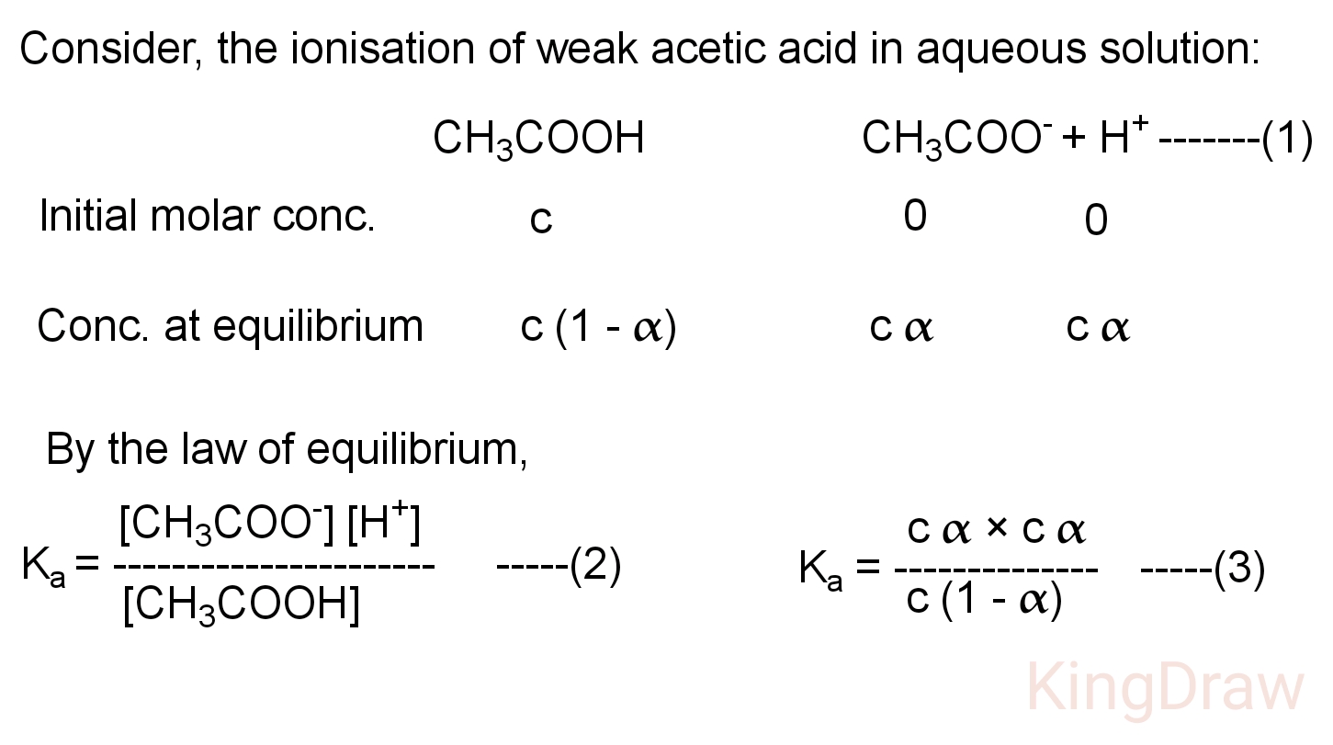
The relation between ionisation constant (Ka), degree of ionisation (α) and initial molar concentration (c) of weak acid

Slide 30
Reference
Essentials of Physical Chemistry by Arun Bahl, B. S. Bahl and G. D. Tuli, S. Chand Publications.
Physical Chemistry, F. Y. B. Sc. (Semester- I), Manali Prakashan, Pune

Slide 31
Savitribai Phule Pune University F. Y. B. Sc. (Semester- I) CH- 101: Physical Chemistry Chapter 3: Ionic Equilibria Lecture: 5
- Sandesh Dasharath Kasar,
Assistant Professor,
Department of Chemistry,
Agasti Arts, Commerce and Dadasaheb Rupwate Science College, Akole

Slide 32
Ionisation constant of weak bases

Slide 33
The ionisation constant of weak base (Kb) is the characteristic constant and it is equal to the product of molar concentration of cation and hydroxyl ion divided by the molar concentration of un- dissociated base.
It varies only with temperature of ionic equilibrium reaction.

Slide 34
The relation between ionisation constant (Kb), degree of ionisation (α) and initial molar concentration (c) of weak base

Slide 35
Equation (2) gives relation between the ionisation constant (Kb) of weak base to the degree of ionisation (𝛂) and initial molar concentration (c) of weak base.

Slide 36
Reference
Essentials of Physical Chemistry by Arun Bahl, B. S. Bahl and G. D. Tuli, S. Chand Publications.
Physical Chemistry, F. Y. B. Sc. (Semester- I), Manali Prakashan, Pune

Slide 37
Savitribai Phule Pune University F. Y. B. Sc. (Semester- I) CH- 101: Physical Chemistry Chapter 3: Ionic Equilibria Lecture: 6
- Sandesh Dasharath Kasar,
Assistant Professor,
Department of Chemistry,
Agasti Arts, Commerce and Dadasaheb Rupwate Science College, Akole

Slide 41
Reference
Essentials of Physical Chemistry by Arun Bahl, B. S. Bahl and G. D. Tuli, S. Chand Publications.
Physical Chemistry, F. Y. B. Sc. (Semester- I), Manali Prakashan, Pune

Slide 42
Savitribai Phule Pune University F. Y. B. Sc. (Semester- I) CH- 101: Physical Chemistry Chapter 3: Ionic Equilibria Lecture: 7
- Sandesh Dasharath Kasar,
Assistant Professor,
Department of Chemistry,
Agasti Arts, Commerce and Dadasaheb Rupwate Science College, Akole

Slide 43
Relation between Ionisation Constants and Ionic Product of Water
The product ionisation constants of conjugate acid and base is equal to the ionic product of water.
Ka × Kb = Kw

Slide 47
Reference
Essentials of Physical Chemistry by Arun Bahl, B. S. Bahl and G. D. Tuli, S. Chand Publications.
Physical Chemistry, F. Y. B. Sc. (Semester- I), Manali Prakashan, Pune

Slide 48
Savitribai Phule Pune University F. Y. B. Sc. (Semester- I) CH- 101: Physical Chemistry Chapter 3: Ionic Equilibria Lecture: 8
- Sandesh Dasharath Kasar,
Assistant Professor,
Department of Chemistry,
Agasti Arts, Commerce and Dadasaheb Rupwate Science College, Akole

Slide 49
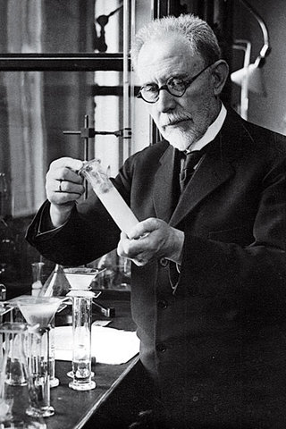
pH scale
The pH scale was introduced by S. P. Sorenson in 1909.
The pH scale measures the acidic or basic nature of substances in aqueous solution.

Slide 50
Definition of pH
It is defined the negative logarithm to the base 10 of the molar concentration of hydrogen ions present in solution.
∴ pH is used to indicate the hydrogen ion concentration.
pH = - log [H+]

Slide 51
pH denotes
'Potential of hydrogen' or
'power of hydrogen'

Slide 54
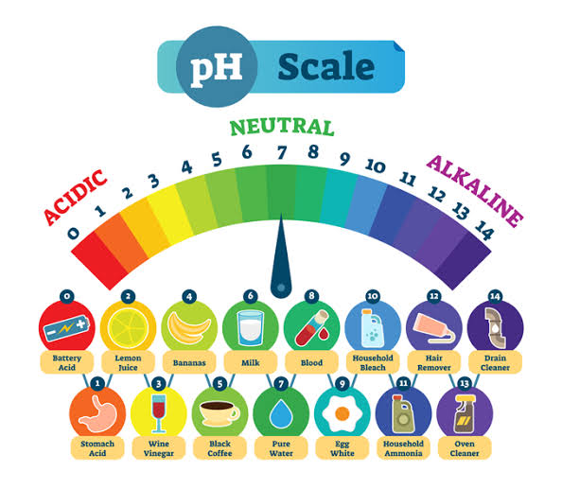

Slide 55
pOH
It is defined as negative logarithm to the base 10 of the molar concentration of hydroxyl ions present in solution.
∴ pOH is used to indicate the hydroxyl ion concentration.
pOH = - log [OH-]

Slide 56
The sum of pH and pOH is equal to 14 for water as well as for any aqueous solution at 25℃.
pH + pOH = 14

Slide 57
Reference
Essentials of Physical Chemistry by Arun Bahl, B. S. Bahl and G. D. Tuli, S. Chand Publications.
Physical Chemistry, F. Y. B. Sc. (Semester- I), Manali Prakashan, Pune

Slide 58
Savitribai Phule Pune University F. Y. B. Sc. (Semester- I) CH- 101: Physical Chemistry Chapter 3: Ionic Equilibria Lecture: 9
- Sandesh Dasharath Kasar,
Assistant Professor,
Department of Chemistry,
Agasti Arts, Commerce and Dadasaheb Rupwate Science College, Akole

Slide 61
Reference
Essentials of Physical Chemistry by Arun Bahl, B. S. Bahl and G. D. Tuli, S. Chand Publications.
Physical Chemistry, F. Y. B. Sc. (Semester- I), Manali Prakashan, Pune

Slide 62
Savitribai Phule Pune University F. Y. B. Sc. (Semester- I) CH- 101: Physical Chemistry Chapter 3: Ionic Equilibria Lecture: 10
- Sandesh Dasharath Kasar,
Assistant Professor,
Department of Chemistry,
Agasti Arts, Commerce and Dadasaheb Rupwate Science College, Akole

Slide 63
Buffer Solutions
An aqueous solution which resists a change in pH on addition of small amounts of an acid or a base is called as buffer solution.

Slide 64
There are two types of buffer solutions
Acidic buffers: maintain the pH value < 7
Basic buffers: maintain the pH value > 7

Slide 65
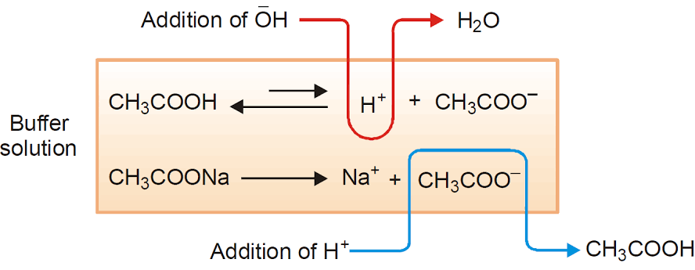
Acidic Buffer and its Mechanism

Slide 66
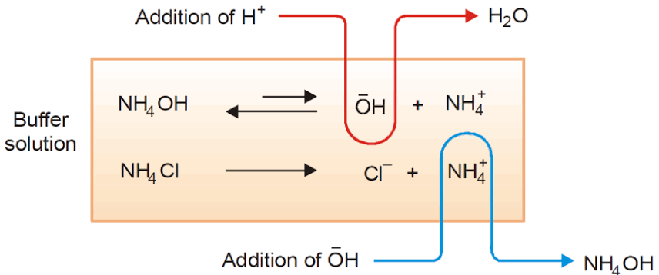
Basic Buffer and its Mechanism

Slide 67
Reference
Essentials of Physical Chemistry by Arun Bahl, B. S. Bahl and G. D. Tuli, S. Chand Publications.
Physical Chemistry, F. Y. B. Sc. (Semester- I), Manali Prakashan, Pune

Slide 68
Savitribai Phule Pune University F. Y. B. Sc. (Semester- I) CH- 101: Physical Chemistry Chapter 3: Ionic Equilibria Lecture: 11
- Sandesh Dasharath Kasar,
Assistant Professor,
Department of Chemistry,
Agasti Arts, Commerce and Dadasaheb Rupwate Science College, Akole

Slide 73
Reference
Essentials of Physical Chemistry by Arun Bahl, B. S. Bahl and G. D. Tuli, S. Chand Publications.
Physical Chemistry, F. Y. B. Sc. (Semester- I), Manali Prakashan, Pune

Slide 74
Savitribai Phule Pune University F. Y. B. Sc. (Semester- I) CH- 101: Physical Chemistry Chapter 3: Ionic Equilibria Lecture: 12
- Sandesh Dasharath Kasar,
Assistant Professor,
Department of Chemistry,
Agasti Arts, Commerce and Dadasaheb Rupwate Science College, Akole

Slide 75
Salt hydrolysis
Hydrolysis of salts is the reverse of neutralisation reaction.

Slide 76
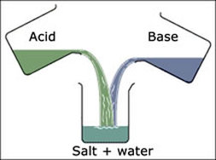
Neutralisation reaction

Slide 77
Salt hydrolysis
The phenomenon of interaction of cations and anions of salt with H+ and OH- ions by water yielding acidic and basic solutions is known as salt hydrolysis.

Slide 78
To study the hydrolysis of salts, it is convenient to divide the salts into four types:
Salts of strong acid and strong base
Salts of weak acid and strong base
e. g. KCl, NaCl, KNO3, NaNO3 etc.
e. g. KCN, CH3COONa, Na3PO4, Na2CO3 etc.

Slide 79
3. Salts of strong acid and weak base
4. Salts of weak acid and weak base
e. g. NH4Cl, CaCl2, NH4NO3 etc.
e. g. CH3COONH4, NH4CN etc.

Slide 80
Reference
Essentials of Physical Chemistry by Arun Bahl, B. S. Bahl and G. D. Tuli, S. Chand Publications.
Physical Chemistry, F. Y. B. Sc. (Semester- I), Manali Prakashan, Pune

Slide 81
Savitribai Phule Pune University F. Y. B. Sc. (Semester- I) CH- 101: Physical Chemistry Chapter 3: Ionic Equilibria Lecture: 13
- Sandesh Dasharath Kasar,
Assistant Professor,
Department of Chemistry,
Agasti Arts, Commerce and Dadasaheb Rupwate Science College, Akole

Slide 82
Hydrolysis of salts of strong acid and strong base
Salts formed by strong acid and strong base on hydrolysis gives strong acid and strong base. Therefore, the solutions are neutral.
i. e. their pH = 1/2 (pKw) = 7 at 25℃
Examples: NaCl, KNO3, CaSO4 etc.

Slide 83
Hydrolysis of salts of weak acid and strong base
Salts of weak acid and strong base on hydrolysis give weak acid and strong base. Therefore, solution is alkaline.
Examples: Na2CO3, KCN, NaCN, Na2S, CH3COONa etc.

Slide 84
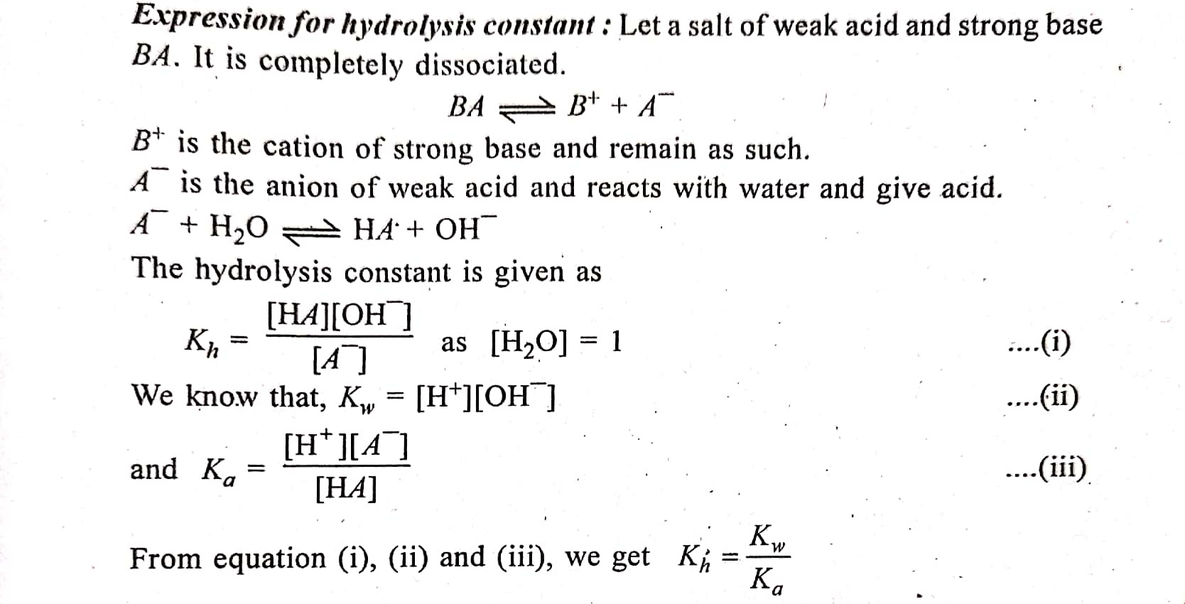
Expression for hydrolysis constant

Slide 85
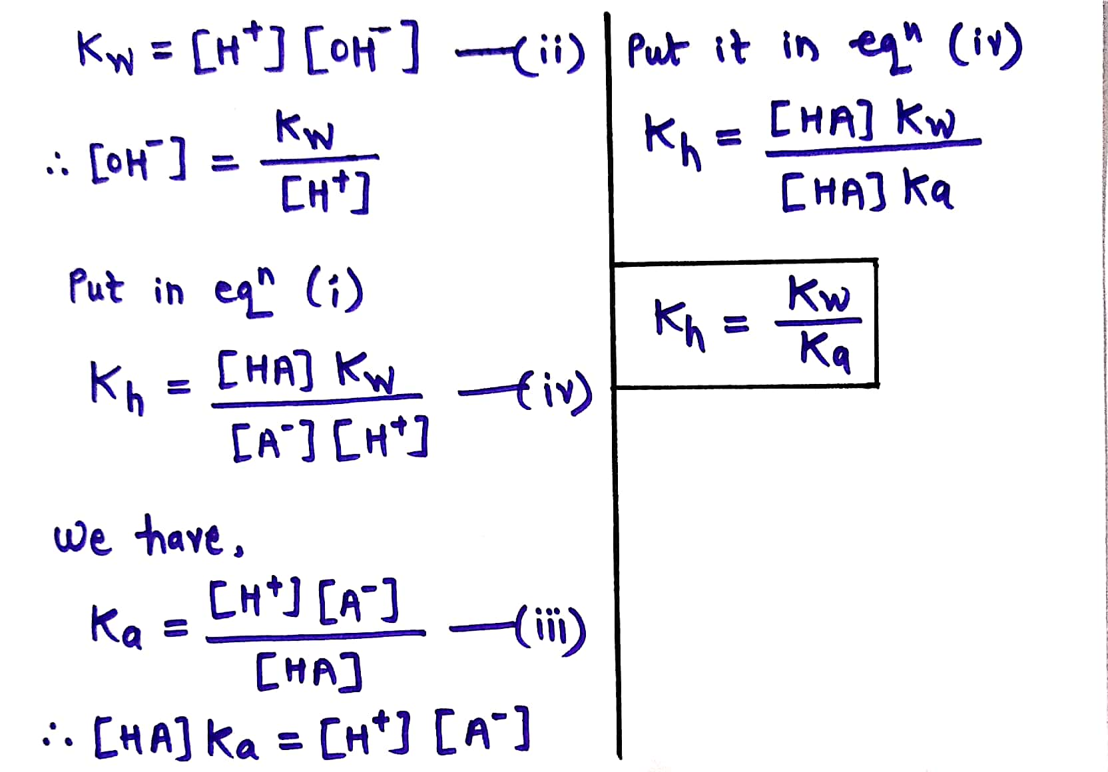

Slide 86
Expression for degree of hydrolysis

Slide 87
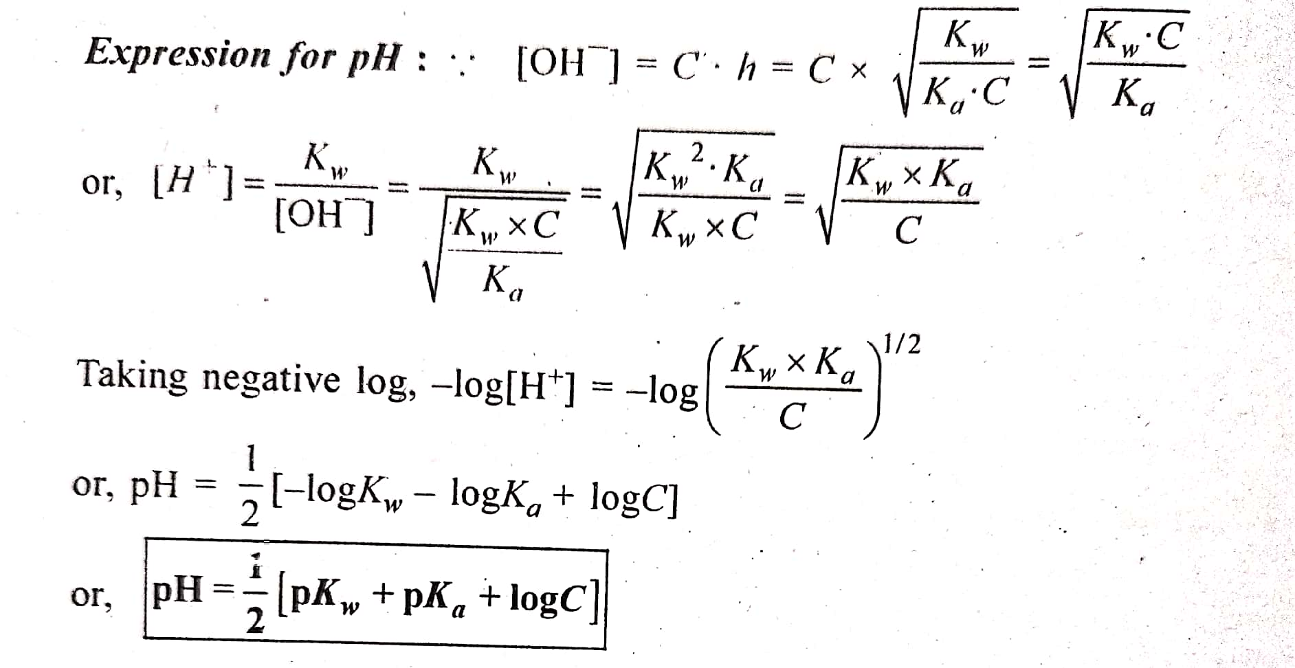
Expression for pH

Slide 88
Reference
Essentials of Physical Chemistry by Arun Bahl, B. S. Bahl and G. D. Tuli, S. Chand Publications.
Physical Chemistry, F. Y. B. Sc. (Semester- I), Manali Prakashan, Pune

Slide 89
Savitribai Phule Pune University F. Y. B. Sc. (Semester- I) CH- 101: Physical Chemistry Chapter 3: Ionic Equilibria Lecture: 14
- Sandesh Dasharath Kasar,
Assistant Professor,
Department of Chemistry,
Agasti Arts, Commerce and Dadasaheb Rupwate Science College, Akole

Slide 90
Hydrolysis of salts of strong acid and weak base
Salts of strong acid and weak base on hydrolysis gives strong acid and weak base. Therefore, solution is acidic (pH < 7).
Examples: CuSO4, FeCl3, NH4Cl etc.

Slide 91
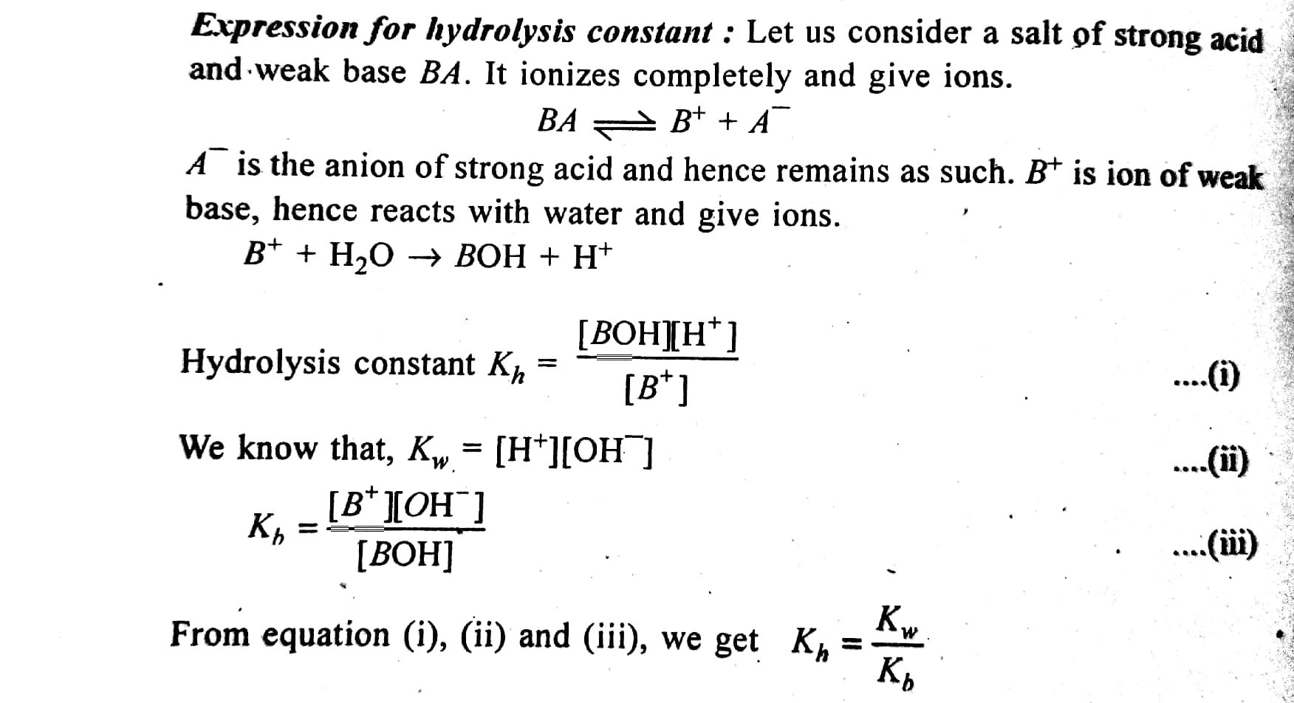
Expression for hydrolysis constant

Slide 92
Expression for degree of hydrolysis

Slide 93
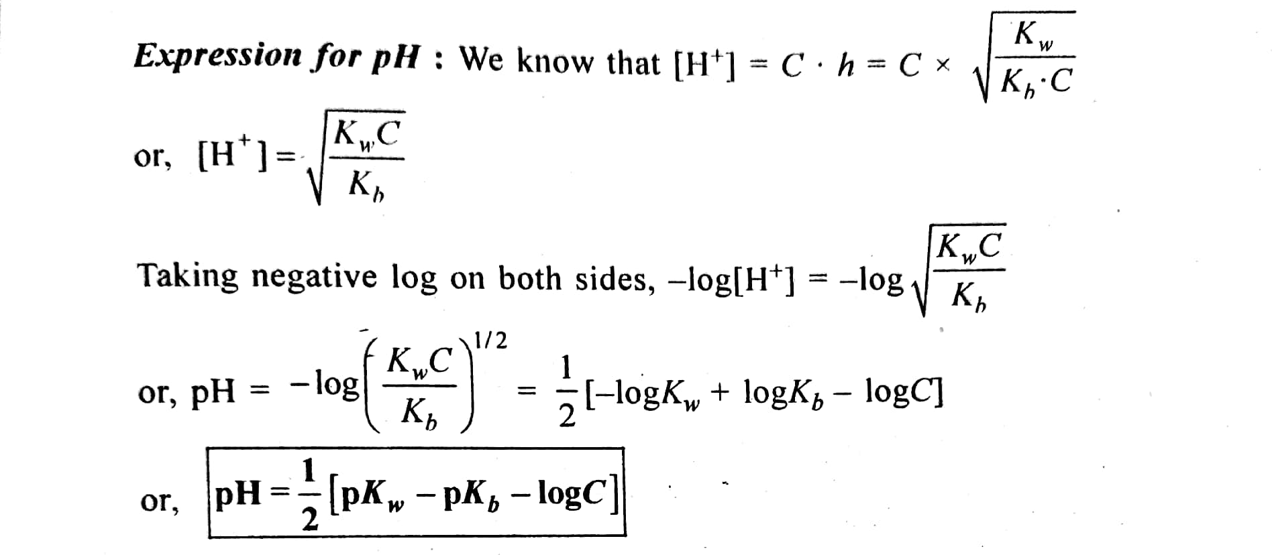
Expression for pH

Slide 94
Reference
Essentials of Physical Chemistry by Arun Bahl, B. S. Bahl and G. D. Tuli, S. Chand Publications.
Physical Chemistry, F. Y. B. Sc. (Semester- I), Manali Prakashan, Pune

Slide 95
Savitribai Phule Pune University F. Y. B. Sc. (Semester- I) CH- 101: Physical Chemistry Chapter 3: Ionic Equilibria Lecture: 15
- Sandesh Dasharath Kasar,
Assistant Professor,
Department of Chemistry,
Agasti Arts, Commerce and Dadasaheb Rupwate Science College, Akole

Slide 96
Hydrolysis of salts of weak acid and weak base
Salts of weak acid and weak base undergo incomplete ionization and each ion react with water to give acid and base.
Examples: (NH4)2CO3, CH3COONH4 etc.

Slide 97
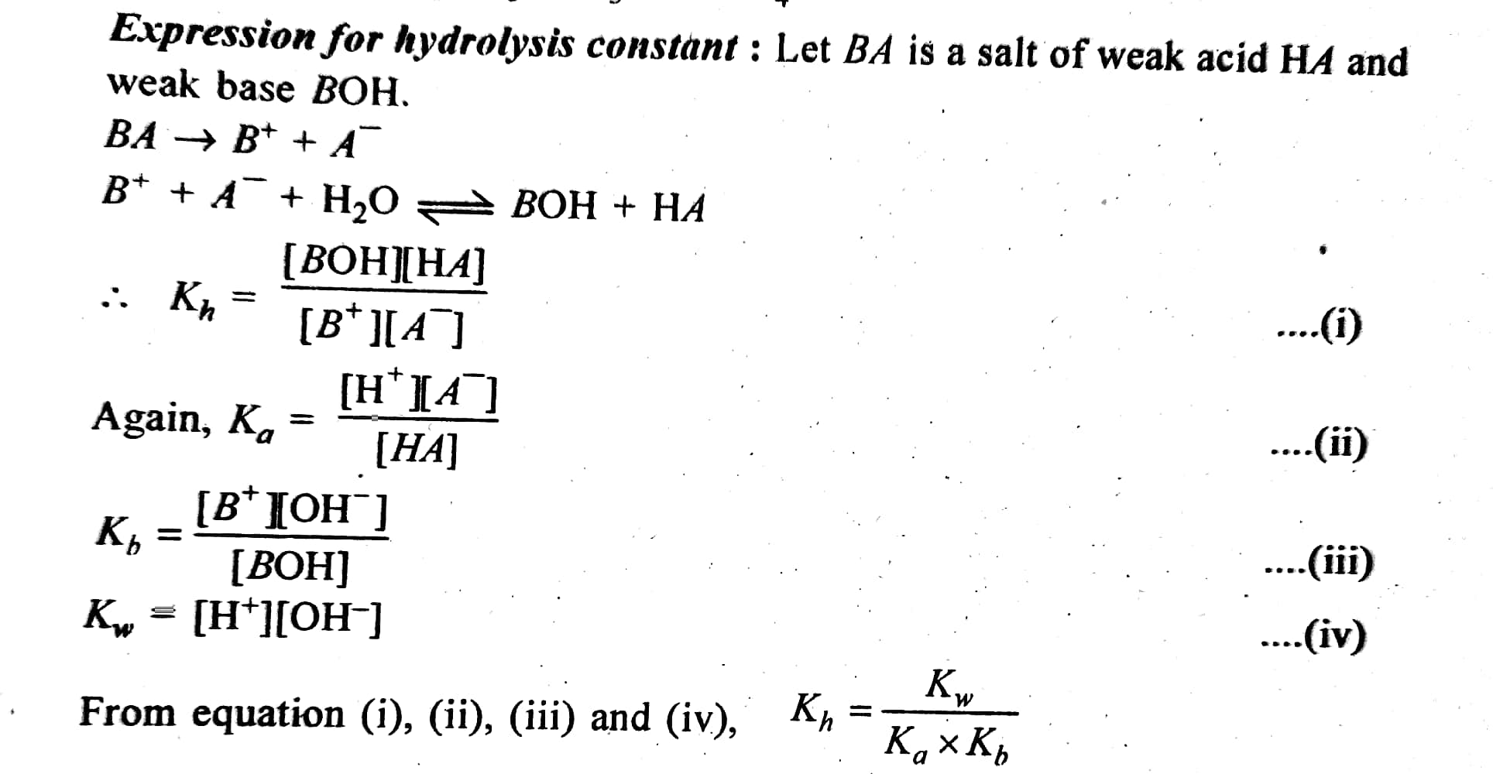
Expression for hydrolysis constant

Slide 98
Expression for degree of hydrolysis

Slide 99
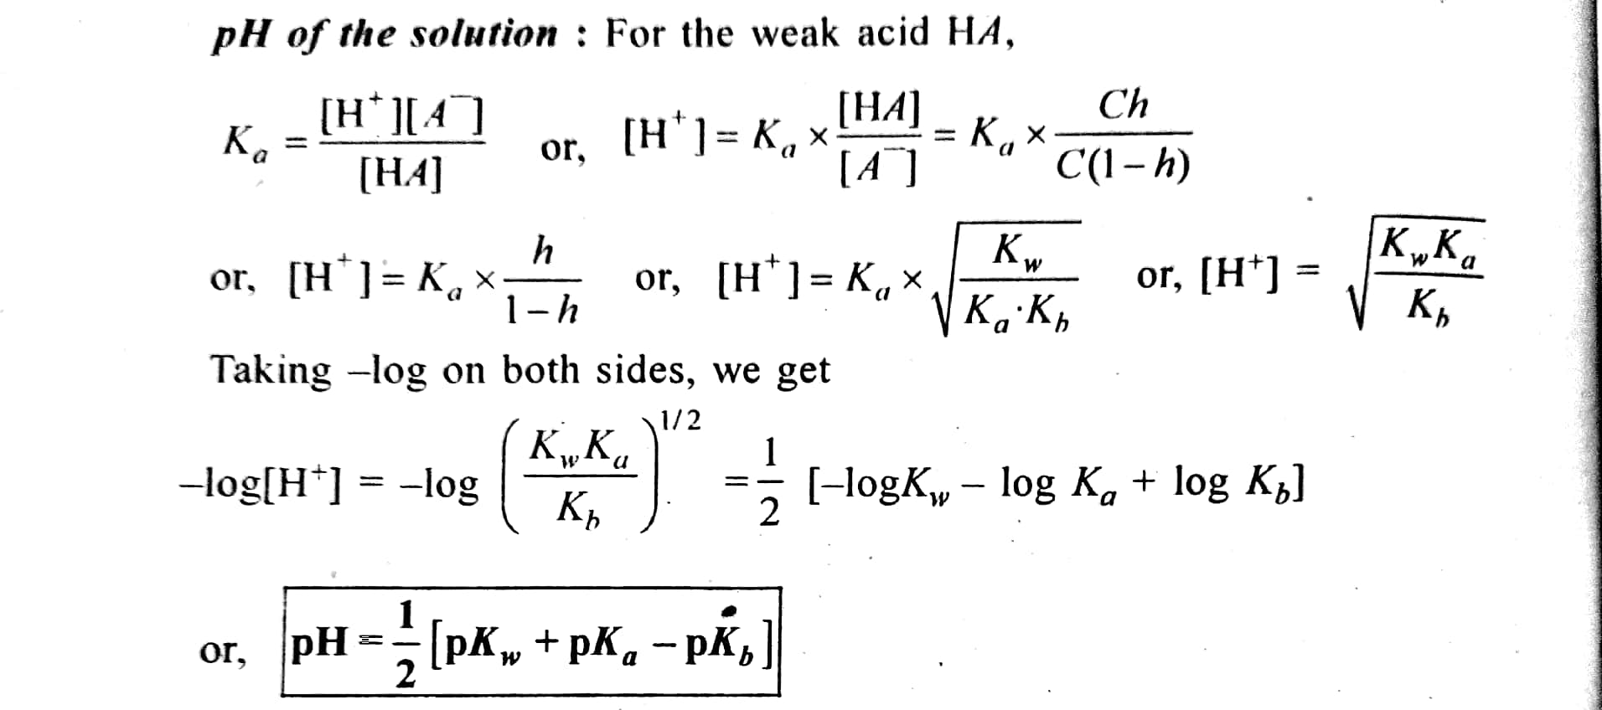
Expression for pH

Slide 100
Reference
Essentials of Physical Chemistry by Arun Bahl, B. S. Bahl and G. D. Tuli, S. Chand Publications.
Physical Chemistry by R. L. Madan, McGraw Hill Education.

Slide 101
Thank You
Like, Subscribe and Share

