Slide 1
AGASTI ARTS,COMMERCE & DADASAHEB RUPWATE SCIENCE COLLEGE,AKOLE
DEPARTMENT OF WINE TECHNOLOGY
S. Y. B. Sc. Wine Brewing And Alcohol Technology
Course Code :WT-302
Subject Name : Fermentation technology paper-I
Presented by – Hase S.D.
Akole Taluka Educaton Society ,Akole 422601
Year 2020-2021

Slide 2
Table of contents
Introduction of fermentation
Defination of fermentation
Types based on fermentation (Areobic and Anaerobic fermentation )
Lactic acid fermentation
Product of fermentation
Advantages and Disadvantages of fermentation
Importance of fermentation

Slide 3
Introduction of fermentation
Fermentation is metabolic process that converts sugar to acids , gases or alcohol . It occurs in yeast and bacteria,and also in oxygen –starved muscle cell, as in the case of lactic acid fermentation.
Fermentation , chemical process by which molecules such as glucose are broken down anaerobically . More broadly , fermentation is the foaming that occurs during the manufacturing of wine and beer ,a process at least 10,000 years old.

Slide 4
Defination
Fermentation is a chemical transformation of organic substance into simpler compounds by the action of enzyme , complex organic catalysts , which are produced by microorganism such as molds ,yeasts ,or bacteria .
Enzyme act by hydrolysis ,a process of breaking down or predigesting complex organic molecules to form smaller compound and nutrients .

Slide 5
Types based on fermentation (Areobic and Anaerobic)
Aerobic Fermentation : Aerobic fermentation means that oxygen is present .wine beer and acetic acid vinegar ,need oxygen in the “primary” or first stage fermentation .
when creating acetic vinegar , for example , exposing the surface the vinegar to as much oxygen as possible creates a healthy ,flavorful vinegar with the correct pH.

Slide 6
Anaerobic Fermantation : Anaerobic fermentation is a method cells use to extract eneargy from carbohydrats when oxygen or other electron acceptors are not available in the surrounding environment .this differentiates it form anaerobic respiration , which doesn’t use oxygen but does use electron –accepting molecules that come from outside of the cell .the process can fallow glycolysis as the next step in the break down of glucose and other sugars to produce molecules of adenosine triphosphate (ATP) that create an energy source for the cell .

Slide 7
There are two major types of anaerobic fermentation :Ethanol fermentation and lactic acid fermentation .Both restore NAD+ to allow a cell to continue generating ATP through glycolysis .
Ethanol fermentation : ethanol fermentation converts teo pyruvate molecules , the products of glycolysis ,to two molecule of ethanol and two molecule of carbon dioxide .The reaction is a two step process in which pyruvate is converted to acetaldehyde and carbon dioxide first , by the enzyme pyeuvate decarbxylase

Slide 8
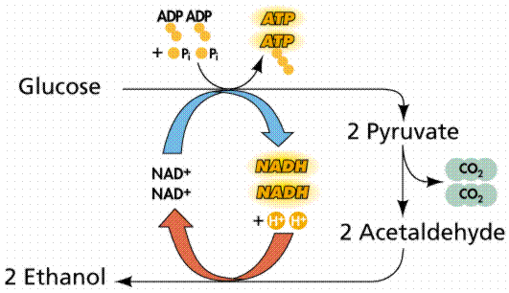
Ethanol fermentation

Slide 9
Lactic acid fermentation : Lactic acid fermentatio is a biological process by which glucose and other six-carbon sugars ( also ,disaccharides of six-carbon sugars , e.g . sucrose or lactose) are converted into cellular energy and the metabolite lactate.
The pyruvate molecule from glucose metabolism (glycolysis) may be fermented into lactic acid fermentation is used to converts lactose into Lactic acid in yogurt production .
THERE ARE TWO TYPES OF LACTIC ACID FERMENTATION
1.Homo Lactic fermentation
2.Hetro lactic fermentation

Slide 10
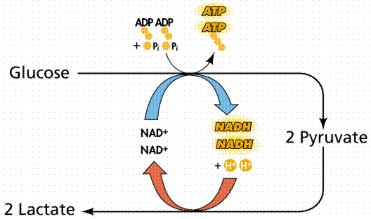
Lactic acid fermentation

Slide 11
Product of fermentation
1.Wine
2.Beer
3. Lactic acid
4. Vinegar
5. Yogurts
6. Cheese
7. Pepperoni
Etc

Slide 12
Advantages and Disadvantages of fermentation
Advantages of fermentation are that lactic acid can be produced and it can produce energy for ATPs.
Disadvantages of fermentation are that production can be slow , the product is impure and need to have further treatment and the production carries a high cost and more energy .

Slide 13
Importance of fermentation
Fermentation is important to cell that don’t have oxygen or cells that don’t use oxygen because :
It allows the cells to get ATP gain from molecule of glucose , even without oxygen .
Fermentation takes away the end product of glycolysis so glycolysis can continue…. Freeing up the electron carries, and so on.
Fermentation is important to baking industry because it is process that yeast uses to produce the bubbles of carbon dioxide that make the dough rise .

