Slide 1
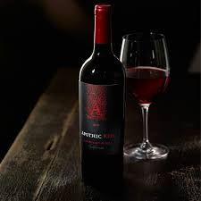

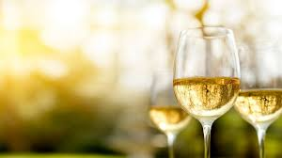
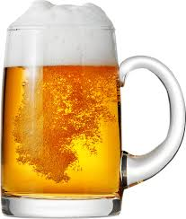
DIFFERENT TYPES OF ALCOHOLIC BEVERAGES
Present By,
HASE S.D.

Slide 2
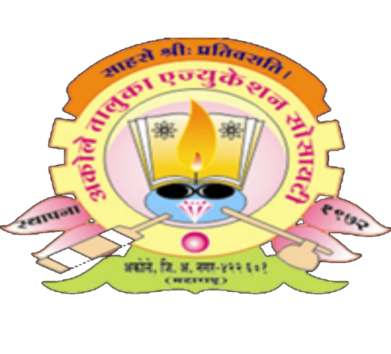
AGASTI ARTS,COMMERCE & DADASAHEB RUPWATE SCIENCE COLLEGE,AKOLE
DEPARTMENT OF WINE TECHNOLOGY
F. Y. B. Sc. Wine, Brewing And Alcohol Technology
Course Code :WT-107 Basic Wine Technology
Akole Taluka Education Society ,Akole 422601
Year 2020-2021

Slide 3
WHAT IS ALCOHOLIC BEVERAGES
An alcoholic drink (or alcoholic beverage) is a drink that contains ethanol, a type of alcohol produced by fermentation of grains, fruits, or other sources of sugar.

Slide 4
TYPES OF ALCOHOLIC DRINK
Wine
Beer
Rum
Gin

Slide 5
1.WINE
Wine is an alcoholic beverage usually made from grapes by fermenting
Yeast consumes the sugar in the grapes and converts it to ethanol, carbondioxide and heat
C₆H₁₂O₆ 2 CO₂+ 2C₂H₅OH
There are different types of wines and wine styles. Basically wines can be classified into two general categories. They are white wines which are colorless and red wines which have the color intensity based on the soaking time.there are also several types of wine sparkling wine,dessert and fortified wine, port wine, rose wine etc.

Slide 6

RED WINE
SPARKLING WINE
WHITE WINE
DESSERT WINE
ROSE WINE
FORTIFIED WINE

Slide 7
1.1 Red wine
Red wines are color wines. Red wines are made from the red grape varieties. These wines get their color by allowing the skin of the grapes to get contact with the grape juice during the wine making process. Red wines are available in different varieties and taste. The most popular red wines are:
Cabernet Sauvignon
Merlot
Pinot Noir
Zinfandel

Slide 8
1.2 WHITE WINE
White wines are generally colorless and they are made from the white grape varieties. Some of the white wines can be made from the red grapes. In such a case the skin of the grapes is not allowed to have any contact with the grape juice. The white wines generally range from dry to sweet wines. The most popular white wines are:
Chardonnay
Riesling
Sauvignon Blanc

Slide 9
1.3 ROSE WINE
Rose wines are also called as Blush wines. Rose wines are not true not truly red, instead they have enough of reddish tinge to make them differentiate from the white wines. Rose wines are prepared from the red grape varieties. The most popular rose wine variety is:
Zinfandel

Slide 10
1.4 SPARKLING WINE
Sparkling wine is a wine with significant levels of carbon dioxide in it, making it fizzy.
Champagne is the most famous sparkling wine in many regions in the world.

Slide 11
1.5 SWEET WINE OR DESSERT WINE
Dessert wines are prepared from the residual sugar that is left in the finished wine. This gives the wine a very sweet taste. Dessert wines vary from off-dry to super, sticky sweet wines. The dessert wines are considered to be the sweetest wines.

Slide 12
1.6 FORTIFIED WINE
Fortified wines are those that are produced with a small addition of the grape spirit. Fortified wines generally include the dry and sweet styles.
Fortified wine is a wine to which a disttiled spirit, usually brandy, is added. Many different styles of fortified wine have been developed, including Port, Sherry, Madeira

Slide 13
1.7 DRY WINE
A dry wine is simply a wine that has no residual sugar, meaning it isn’t sweet.
When grape juice converts to wine, alcohol is produced in the fermentation process because yeast eats the sugar present in the juice.
In many wines, the winemaker stops the fermentation process before the yeast has time to eat all the sugar, leaving the wine a touch sweet. When a winemaker leaves a little sugar behind, we call this residual sugar.
To make a dry wine, the winemaker will instead let the fermentation process finish completely, allowing the yeast to consume all the sugar present. No more sugar, so no sugary sweetness; the wine is therefore dry.
A wine that creates a drying sensation inside your mouth is a wine that is strong in tannins

Slide 14
1.8 PORT WINE
a strong, sweet dark red (occasionally brown or white) fortified wine, originally from Portugal, typically drunk as a dessert wine.

Slide 15
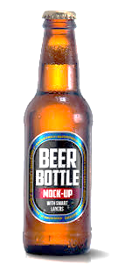
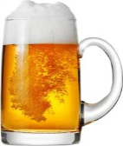
2. BEER
Beer is one of the oldest and most widely consumed alcoholic drinks in the world, and the third most popular drink overall after water and tea. Beer is brewed from cereal grains most commonly from malted barley, though wheat, maize (corn), and rice are also used.
Beer is any alcoholic beverage made by the fermentation of grain, just as wine is any alcoholic beverage made by the fermentation of fruit.

Slide 16
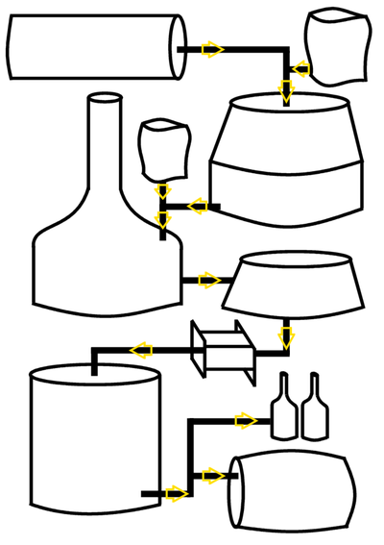
The process of brewing beer
Hot water tank
malt
hops
Mash tun
copper
hopback
Heat exchanger
Add yeast to fermenter
bottling
Cask or keg

Slide 17
The brewing process commonly begins with malted barley or malt
The malt is heated with water in a large kettle called a “mash tun.” At the end of mashing, the starches in the malt have been broken down into simple sugars, resulting in a sweet liquid known as “wort.”
The wort is piped into the next large tank in the brewery, the brew kettle. Here, hopes (green, cone-like flowers) are added and boiled with the liquid, providing bitterness and aroma.
After boiling, the wort is rapidly cooled until it is at the right temperature to add yeast, the single-celled organisms that do the work of fermentation.

Slide 18
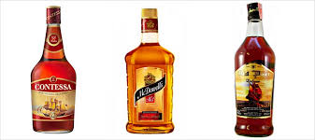
3.RUM
Rum is a distilled beverage made from sugarcane products. Eg. Molasses and sugarcane juice
Making of Rum Firstly the sugarcane is harvested and crushed to remove the juice. During the process of making sugar we get a by product call molasses which forms the base of most Rums.
Yeast, water added to molasses to start fermentation Fermentation

Slide 19
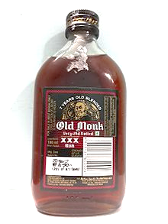
Then the fermenting liquid is distilled.Pot still distillation for darker rums Patent still distillation for light rums

Slide 20
4.GIN
Gin is liquor that derives its predominant flavour from juniper berries (Juniperus communis). Gin is one of the broadest categories of spirits.
Gin is made primarily from a mixture of malted barley, wheat, corn and rye. It is an un-aged spirit. The botanicals which are used to flavour gin are anise, coriander, cassia bark, cinnamon stick, orange peel etc.

Slide 21
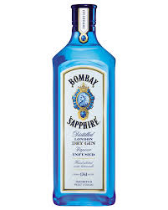
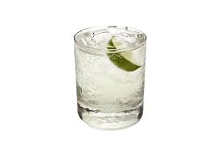
METHODS OF PRODUCTION
Percolation : In this method alcohol vapor wafts through a chamber in which the dried juniper berries and botanicals are suspended. The vapor gently extracts aromatic and flavoring oils and compounds from the berries and spices as it travels through the chamber.
Mixing : Mixing the spirit base with juniper and botanical extracts.
Steeping : Most of the gin available in the market is produced by this method wherein juniper berries and botanicals are steeped in the spirit and then redistilled.

Slide 22
THANK YOU

